Slide 1
(r) among Toronto’s Heritage Italians: maintaining language internal Homeland patterns
Heritage Language Variation and Change in Toronto
ngn.artsci.utoronto.ca/HLVC
WILA 13 (11/12/2022)
Angela Cristiano a.cristiano@rug.nl
Naomi Nagy naomi.nagy@utoronto.ca
Notes:
Work Angela conducted under my supervision while visiting UofT last year. WE had great fun investigating TITLE.
A was surprised by how much the heritage speakers maintained HOM patterns,
and I was surprised to learn that HOM ITA includes a very “English-sounding rhotic.

Slide 2
Research questions
Minority varieties in contact situations: attrition, grammar simplification, or transfer from the majority language (Benmamoun et al. 2013; Polinsky 2018)
Can we find evidence of contact effects or of language-internal lenition?
ITALIAN RHOTICS | CANADIAN ENGLISH RHOTICS
Taps, trills, approximants, fricatives | Approximants
(r) among Toronto’s Heritage Italians Cristiano, A., & Nagy, N. | WILA13, 11/12/2022
Notes:
This makes the variable R a great place to test common assumptions about HL behaviour by comparing the behaviour of a language when it is a minority variety vs. when it is the majority lg of a country, to better understand what processes may apply in the minority context.
Q:
Why rhotics? → articulatory complexity and flexibility make them prone to variation and change (van Hout e Van de Velde, 2001; Scobbie, 2006).
Also, as I showed yesterday, we can study in lots of lgs whose «r» differs from that in English.

Slide 3
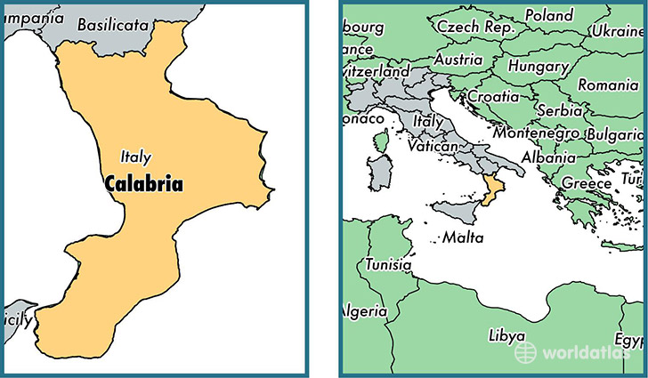
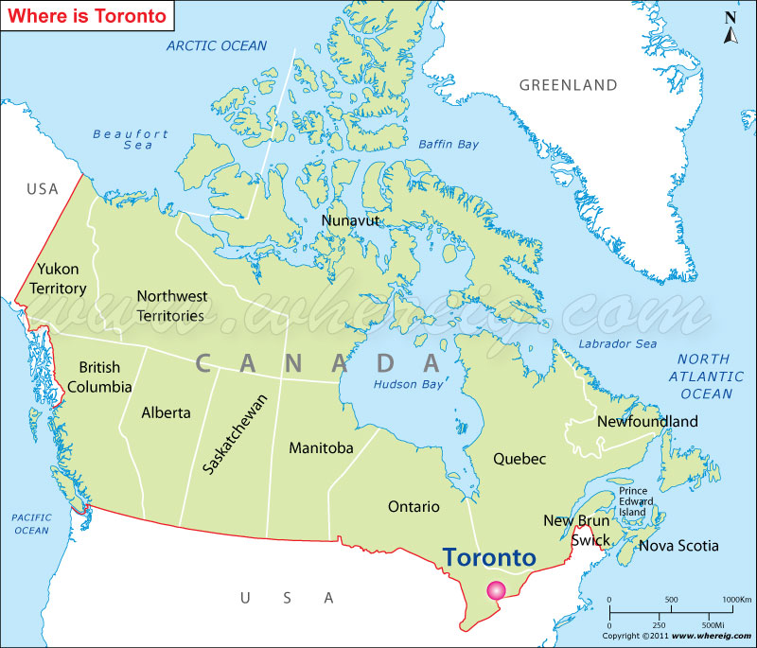
Homeland Calabrian
Toronto’s Heritage Calabrian
Rhotics
in these varieties
Fr
Sw
Mediterranean
A
pt
WI
Regional Southern Italian variety
Canadian English: majority language in the city
Less lenited
More lenited
[r], [ɾ])
[ɾɹ̝̊]
[ɹ]
[ɹ]
[ɹ]
(r) among Toronto’s Heritage Italians Cristiano, A., & Nagy, N. | WILA13, 11/12/2022
Notes:
In the Italian repertoire of both Homeland and Heritage speakers, we find two standard rhotics – taps&trills - and, among non-standard rhotics, fric and approx variants.
There are claims in literature suggesting approximants are the endpoint of a pattern of rhotic lenition. Hence, their presence in both Homeland and Heritage communities may suggest an ongoing pattern of lenition. On the other hand, the Heritage community has contact with the majority language of Toronto, Canadian English, whose only rhotic is the approximant. Therefore, it is also possible that the influence of Canadian English has led to a contact-induced change: an increase of approximant variants in Heritage Italian speakers compared to Homeland speakers.
Let’s see…

Slide 4
Methods and materials for Variationist analysis
HLVC (Nagy 2011) Calabrian Italian spontaneous conversational data
Sample | Tokens | Dependent variable (r) | Analysis
29 speakers | n = 1555 | Word-internal, singleton /r/ e.g., ristorante ‘restaurant’ | Mixed effects modeling
Homeland Heritage Generation 1 Heritage Generation 2 | 20 frequent word types | Variants: Taps&trills ([r] e [ɾ]) Fricative ([ɾɹ̝̊]) (lenited) Approximant ([ɹ]) (lenited and like English [ɹ]) | Reduced (approximants & fricatives) vs. non-reduced (taps & trills) variants
 |  |  | Linguistic and social factors as fixed effects, speaker and word type as random intercepts
(r) among Toronto’s Heritage Italians Cristiano, A., & Nagy, N. | WILA13, 11/12/2022
Notes:
Q:
Tokens per speaker: ca. 40/60

Slide 5
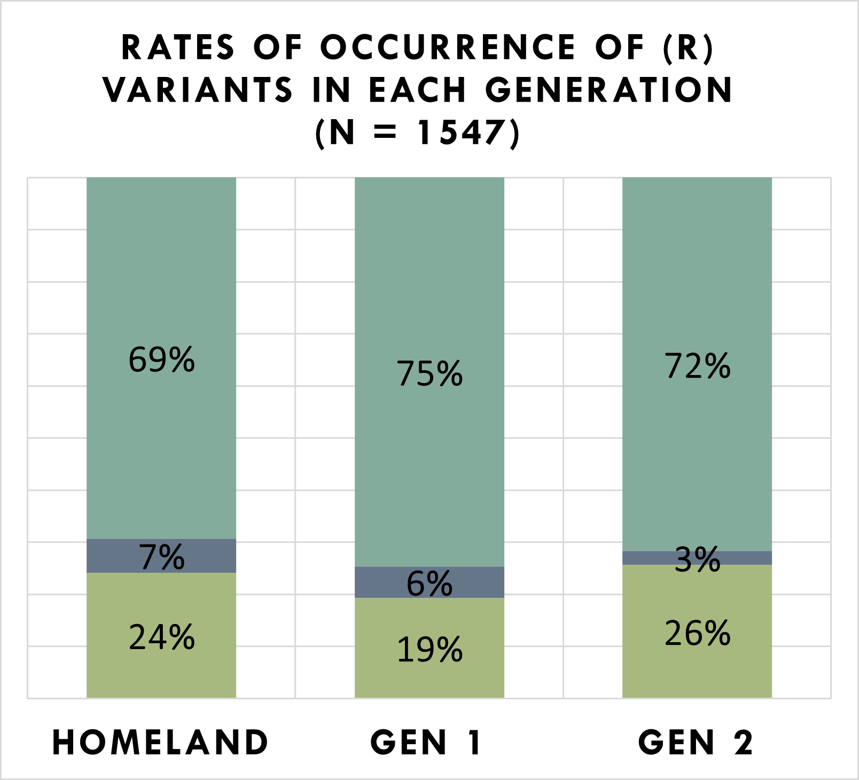
Results: Stable Variation
Factor | Homeland | Gen 1 | Gen 2
Syllable position | √ | √
Stress of syllable x Syllable position |  |  | √
Sex x Age | √ | √ | √
√ = Significant
Results of Mixed Effects models comparing reduced vs. non-reduced (r) variants, for each speaker group
n 655 406 456
Taps&trills Fricatives Approximants
(r) among Toronto’s Heritage Italians Cristiano, A., & Nagy, N. | WILA13, 11/12/2022
Notes:
On the left, we see x-gen stability in distribution of the 3 types of rhotics.
Turning to the effects of the conditioning factors, we see consistency again:
Reduced variants are favored by:
Codas compared to onsets
Males compared to females
Older speakers compared to younger speakers

Slide 6
TRANSMISSION of a language-internal process
No generational differences, the grammar constraining (r) is maintained
no signs of transfer from English among Heritage speakers
Heritage speakers acquire and replicate not only linguistic constraints, but also social constraints
(r) among Toronto’s Heritage Italians Cristiano, A., & Nagy, N. | WILA13, 11/12/2022
Notes:
The consistent patterns of variation suggest transmission of a language-internal process

Slide 7
DUAL CAUSES
Coda effect → synchronic lenition caused by target undershoot (Bauer 2008; Kirchner 1998; Gillian & Jaworski 2014)
Heritage speakers increase the relative strength of this constraint → grammar boosting (Flores & Rinke 2020; Umbal & Nagy 2021)
(r) among Toronto’s Heritage Italians Cristiano, A., & Nagy, N. | WILA13, 11/12/2022
Notes:
Coda contexts usually favor reduced/lenited variants. We know from the literature that approx. and fricatives emerge from underlying trills and taps due to target undershoot. As they behave the same in every group, the process involved must be one caused by universal mechanisms, such as the motor ones involved in hypospeech. We also have cross-linguistic evidence of similar rhotic patterns.
But HL speakers additionally have the impetus of the reduced form “soundling like” an English variant, which seems to amplify or boost the effect size.
----
Lenition has been defined as “synchronic alternations, as well as diachronic sound changes, whereby a sound becomes “weaker”, or where a “weaker” sound bears an allophonic relation to a “stronger” sound. […] The core idea, as applied to consonants, is some reduction in constriction degree or duration” (Kirchner, 1998, 3). An alternative definition is “the failure to reach a phonetically specified target: articulatory undershoot or under-achievement. […] It is only if we view the process diachronically that we can see what looks like lenition27” (Bauer, 2008, 611; 615).

Slide 8
OTHER (R)’s in HLVc
Umbal & Nagy (2021), Cristiano (2022), and thanks to Julia Petrosov & Olha Mamitko for brand new analyses.
Notes:
As noted yesterday, this leads us to reconsider interpretation of APPARENT contact-induced effects on r in other lgs.

Slide 9
감사합니다
Molte grazie
Спасибо
Köszönöm
Obrigada
多謝
дякую
Salamat
gratsiə namuor:ə
Dziękuję Ci
a.cristiano@rug.nl
naomi.nagy@utoronto.ca
ngn.artsci.utoronto.ca/HLVC
HLVC RAs for Italian
Anissa Baird
Vanessa Bertone
Rosanna Calla
Vivien Chow
Courtney Clinton
Marco Covi
Paolo Frascà
Tim Gadanidis
Julia Grasso
Alex La Gamba
Carmela La Rosa
Arash Lotfi
Walter Mancini
Lisa Marando
Francesco Muoio
Maria Parascandolo
Josephine Petrolo
Alessia Plastina
Matteo Talotta
Awet Tekeste
Letizia Tesi
Notes:
Please leave this slide up during Q&A (unless you have to go back to another).
I have to show the SSHRC and UofT logos because they provided funding for the corpus.
Add Groningen logo? and/or U Bologna’s, if they supported you as you did the work

Slide 10
references
Bauer, L. (2008). Lenition revisited. Journal of Linguistics, 44, 605-624.
Benmamoun, E., Montrul, S., & Polinsky, M. (2013). Heritage Languages and Their Speakers: Opportunities and Challenges for Linguistics. Theoretical Linguistics, 39 (3-4), 129-181.
Cristiano, A. (2022). (r) in Heritage Calabrese Italian: Cross-generational nativeness. Unpublished Master’s thesis, University of Bologna.
Flores, C., & Rinke, E. (2020). The relevance of language-internal variation in predicting heritage language grammars. Bilingualism: Language and Cognition, 23, 25-26.
Gillian, E., & Jaworski, S. (2014). A Discussion of Walpiri and Polish rhotics. Unity in Diversity, 2, 133-148.
Kirchner, R. M. (1998). An effort-based approach to consonant lenition. PhD Dissertation, University of California, Los Angeles.
Nagy, N. (2011). A multilingual corpus to explore geographic variation. Rassegna Italiana di Linguistica Applicata, 43 (1-2), 65-84.
Polinsky, M. (2018). Heritage languages and their speakers (Vol. 159). Cambridge, UK: Cambridge University Press.
Umbal, P., & Nagy, N. (2021). Heritage Tagalog Phonology and a Variationist Framework of Language Contact. Languages, 6, 201.
(r) among Toronto’s Heritage Italians Cristiano, A., & Nagy, N. | WILA13, 11/12/2022

